Slide 1

Eco Committee Assembly

Slide 2
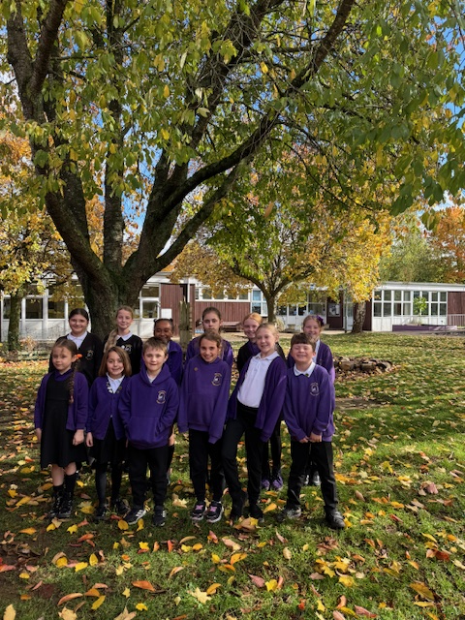
Hello and welcome to our assembly!
We are the Eco Warriors for Gateway this year!
We have lots of exciting projects planned to help make our school more environmentally friendly.
First, we will tell you about our Eco Code.
It’s a simple set of rules to help us be more eco friendly. They will be up in our classrooms to help remind us.

Slide 3
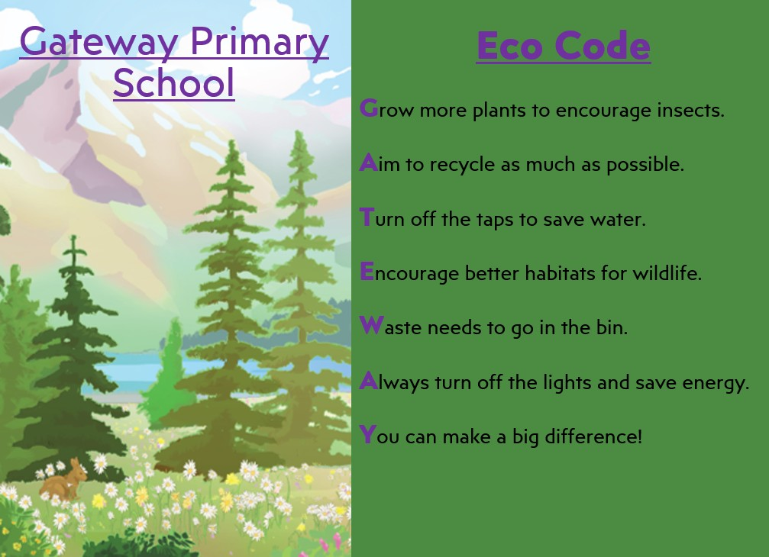

Slide 4
Our Eco Projects
This year we are working on three areas: Biodiversity, Litter and School Grounds.
Biodiversity is about improving a variety of habitats and homes for animals, birds and insects.
School Grounds is about making the school grounds even better for wildlife, plants and learning outdoors.
Litter is about reducing waste and making sure our local area is clean and safe for animals, birds and insects.

Slide 5
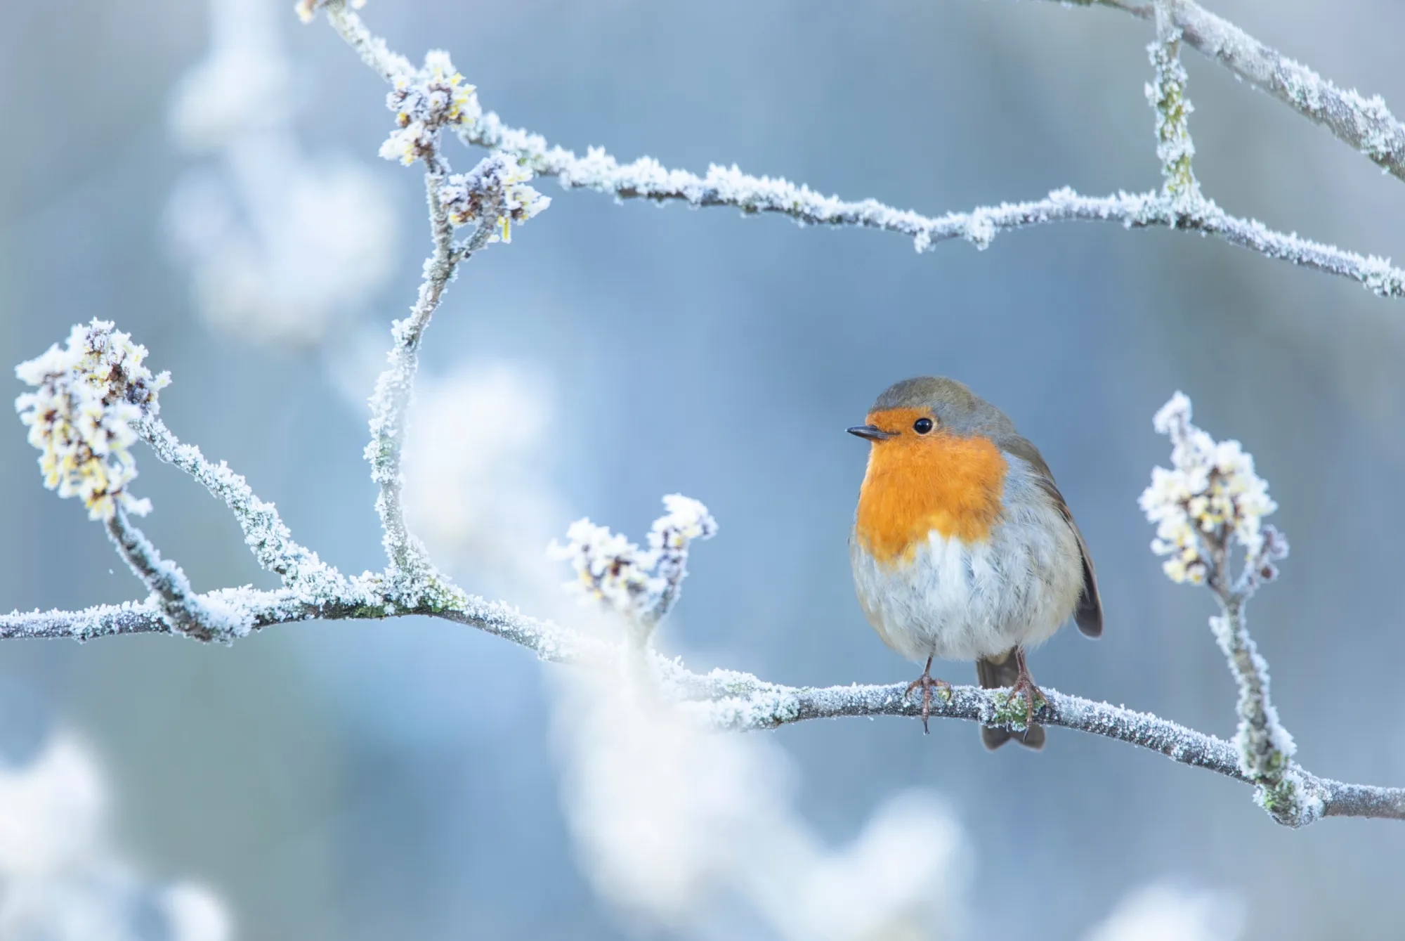
The Big Birdwatch
We are taking part in the Big School Birdwatch this year.
You will spend some time outside with your class, looking out for birds in the school grounds.
You will record the results and then give them to the Eco Committee.
You need to count between 12th January and 13th February.

Slide 6
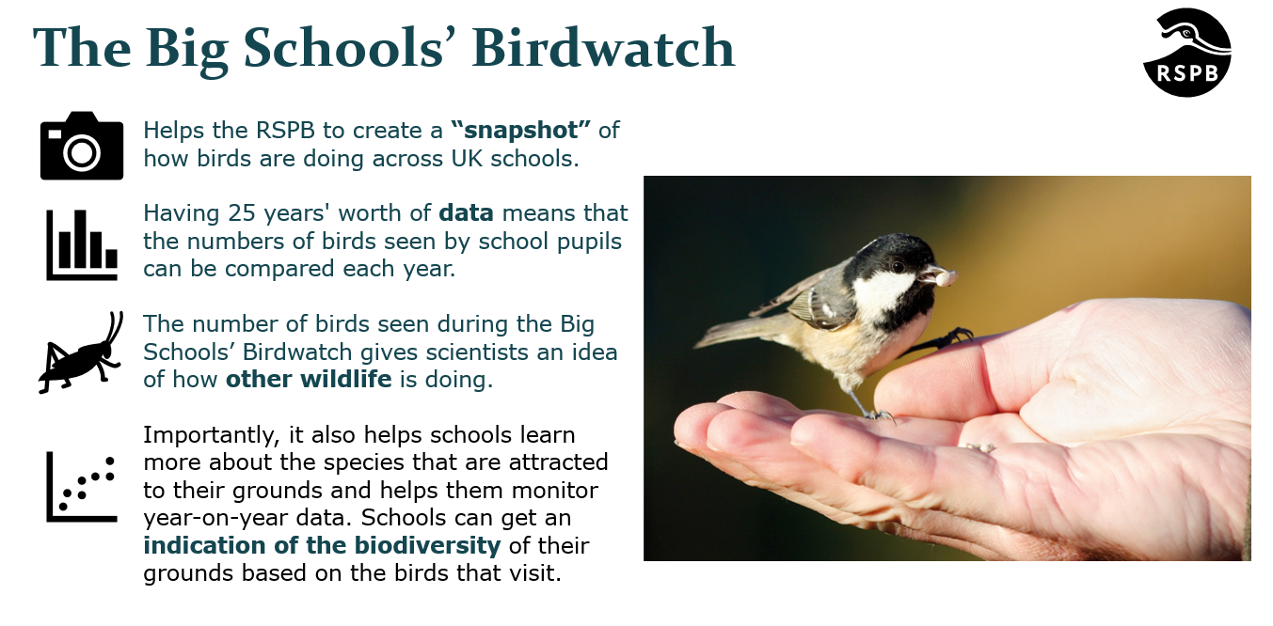

Slide 7
Litter Monitors
We would like to create some Litter Monitors, who look after the playgrounds and classrooms to make sure there is no litter!
Please let your class Eco Warrior know if you are interested.

Slide 8
Thank you!
Thank you for listening to our assembly.
Any questions?

